Slide 1

Scripting & Parallelization
SLURM
Sbatch, JobArray, OpenMP/MPI
Daniel Valle Millares
(Bioinformatics Platform - CIBERINFEC)
BU-ISCIII
29-04 de octubre de 2025
1ª edición

Slide 2
Index
Scripting on the cluster — Slurm: sbatch & job arrays
Parallelization on our cluster — OpenMP vs MPI (when to use each)
From scripts to workflows — building a reproducible pipeline (Nextflow preview)
Wrap-up & Q&A

Slide 3
Index
Scripting on the cluster — Slurm: sbatch & job arrays
Parallelization on our cluster — OpenMP vs MPI (when to use each)
From scripts to workflows — building a reproducible pipeline (Nextflow preview)
Wrap-up & Q&A

Slide 4
Sbatch File

Slide 5
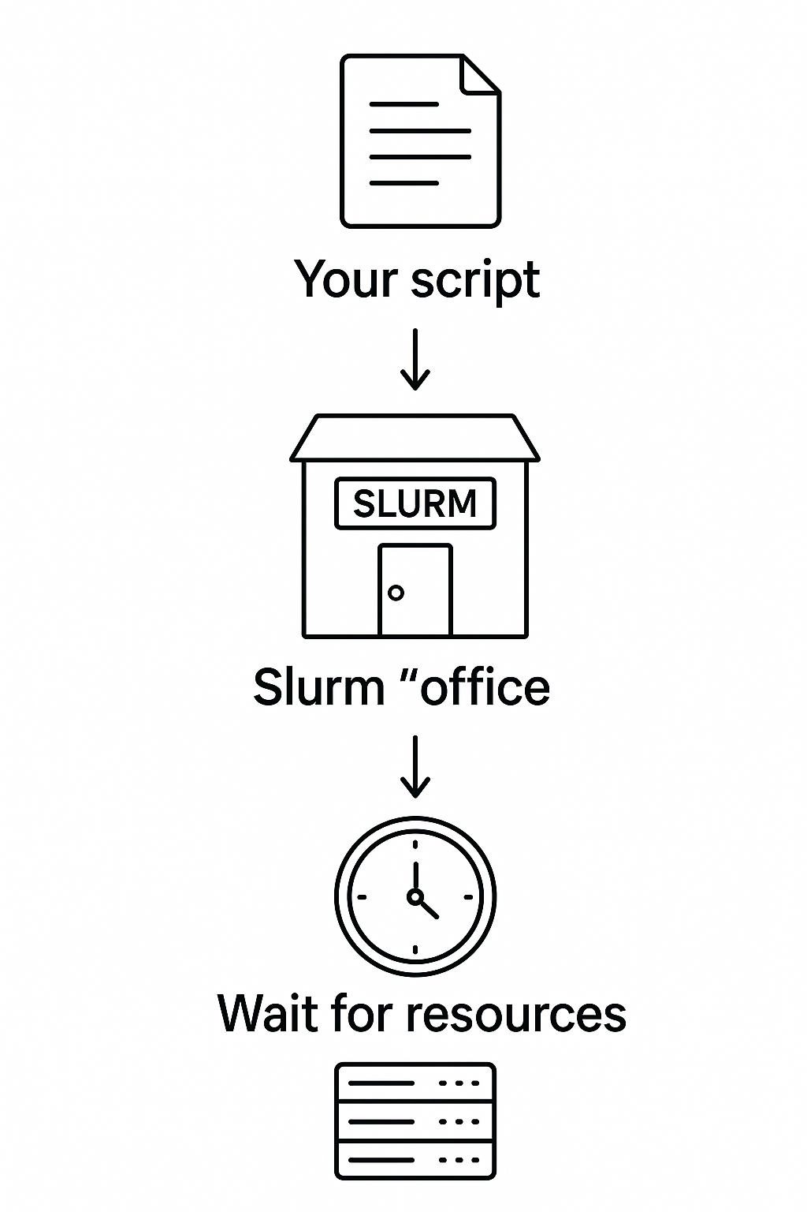
Scripting on the cluster — Slurm: sbatch
What is sbatch?
Command to submit a job script to Slurm; runs in the background on compute nodes.
Delegate the work to de cluster:
Submit once, let the cluster work
Example:
Your script → Slurm "office" → Wait for resources → Cluster runs it

Slide 6
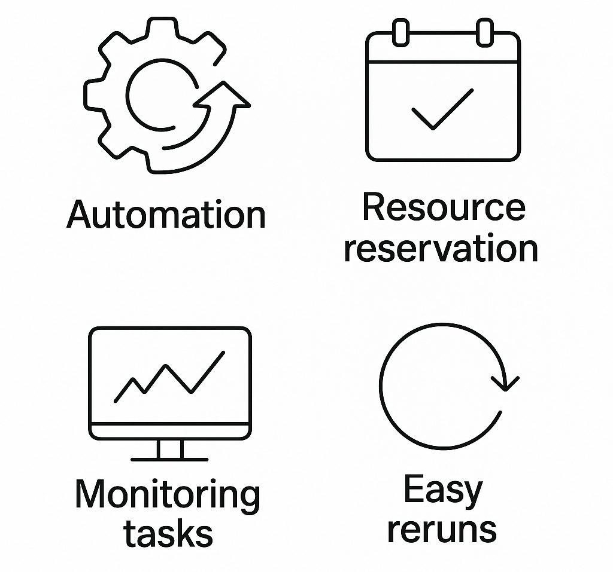
Scripting on the cluster — Slurm: sbatch
What is for?
Automation
Resource reservation
Monitoring tasks
Easy reruns

Slide 7

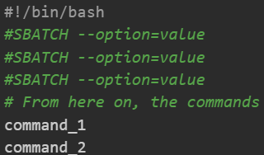
Scripting on the cluster — Slurm: sbatch & job arrays
Set up a sbatch script file
1) Create an SBATCH script
2) Init with shebang
3) Set up slurm directives at the beginning of the script by using “#SBATCH”
3) After directives, you can:
Load dependencies with ‘module load’
Set your commands you want to run

Slide 8
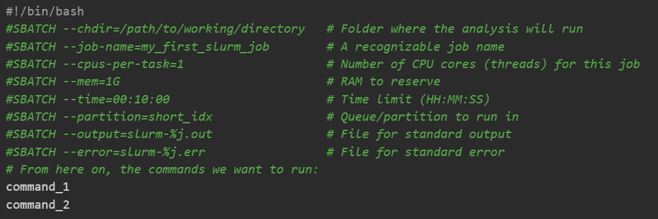
Scripting on the cluster — Slurm: sbatch & job arrays

Slide 9
Scripting on the cluster — Slurm: sbatch & job arrays
Submit sbatch file and monitor execution
Submit a job with sbatch <filename>.sbatch
→ “Submitted batch job 12345”
States: PD (Pending) → R (Running) → CG (Completing) → finished
Monitor while it runs using: squeue

Slide 10
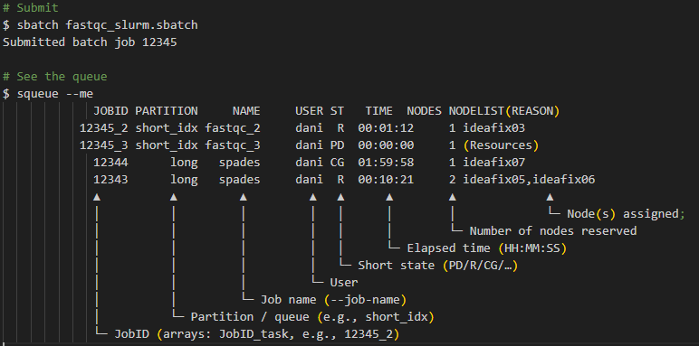
Scripting on the cluster — Slurm: sbatch & job arrays

Slide 11
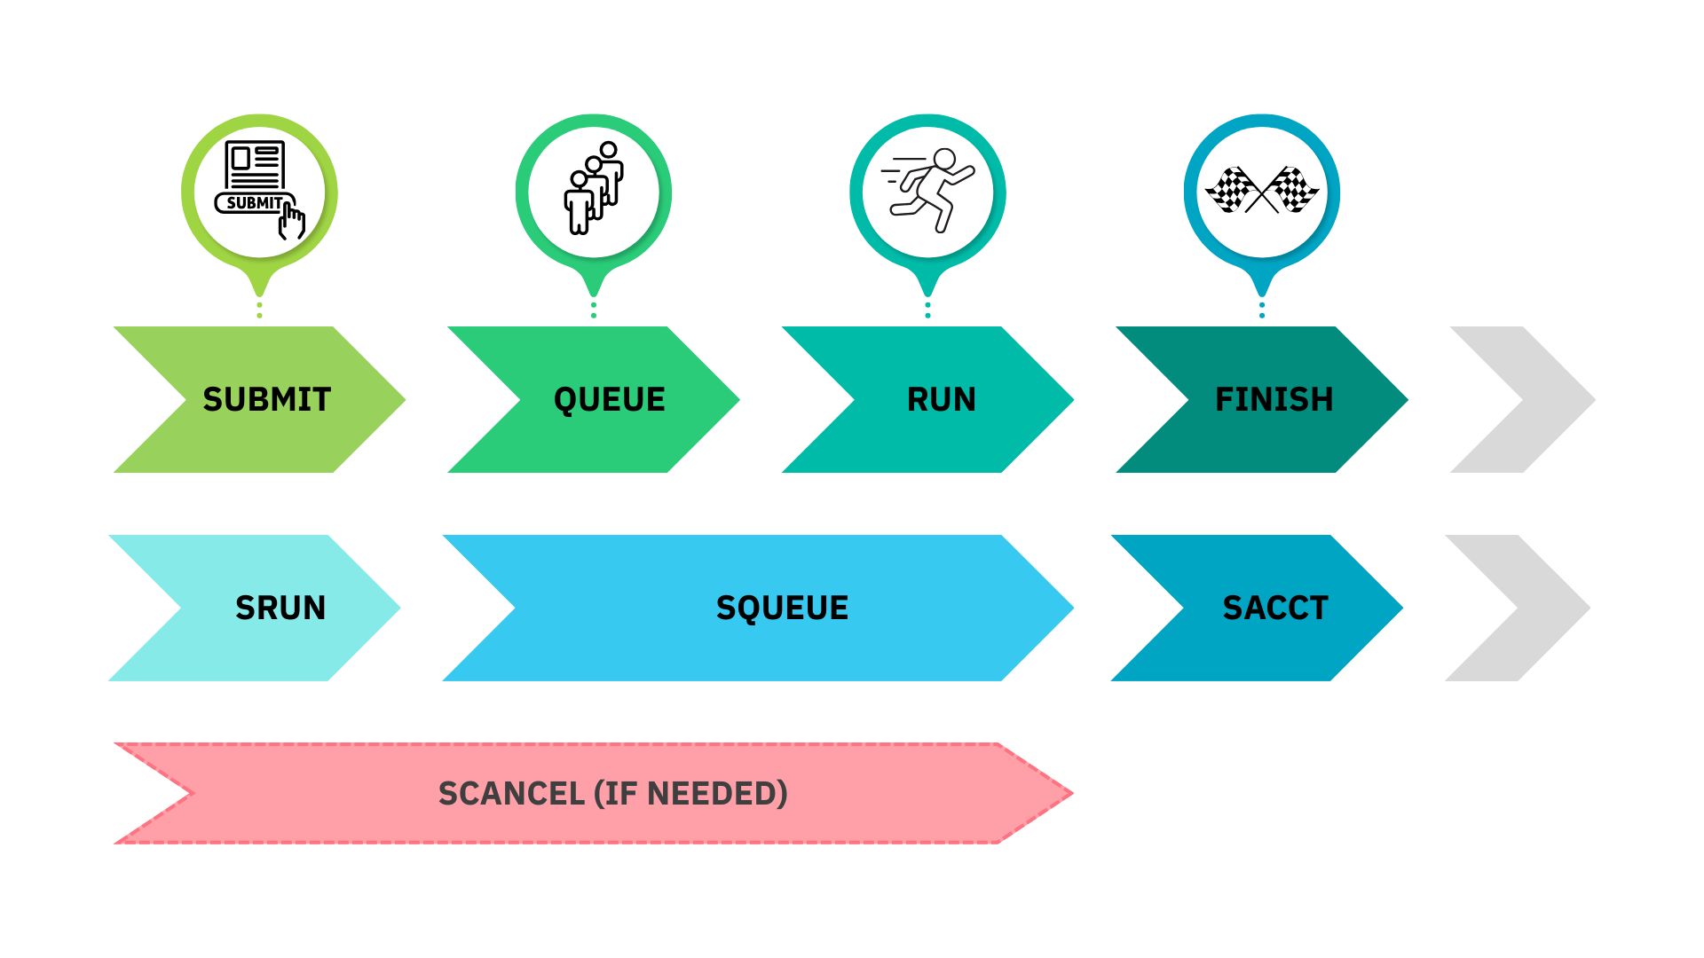
Monitoring and job states

Slide 12

Scripting on the cluster — Slurm: sbatch & job arrays
Bigger asks = longer wait, not faster.

Slide 13

Scripting on the cluster — Slurm: sbatch & job arrays
Output files
Standard output: Standard outputs of your program
Standard error: Potential errors you face during execution appear here.
slurm-12345.out
slurm-12345.err

Slide 14

Scripting on the cluster — Slurm: sbatch & job arrays
Good Practices:
Descriptive --job-name; comment your script.
Never run heavy jobs on the login node—use sbatch/srun.
Start small, then scale.
Version your scripts (Git).

Slide 15
Thank you for your attention
Questions?

Slide 16
JobArrays

Slide 17
Scripting on the cluster — Slurm: job arrays
What are JobArrays and what are they used for?
Sbatch script designed to launch many jobs
Same operation / multiple inputs
Instead of creating 50 scripts for 50 samples, you create one script and tell Slurm to run it N times → In Parallel
If your shell for loop only changes a filename/ID, make it a job array.

Slide 18
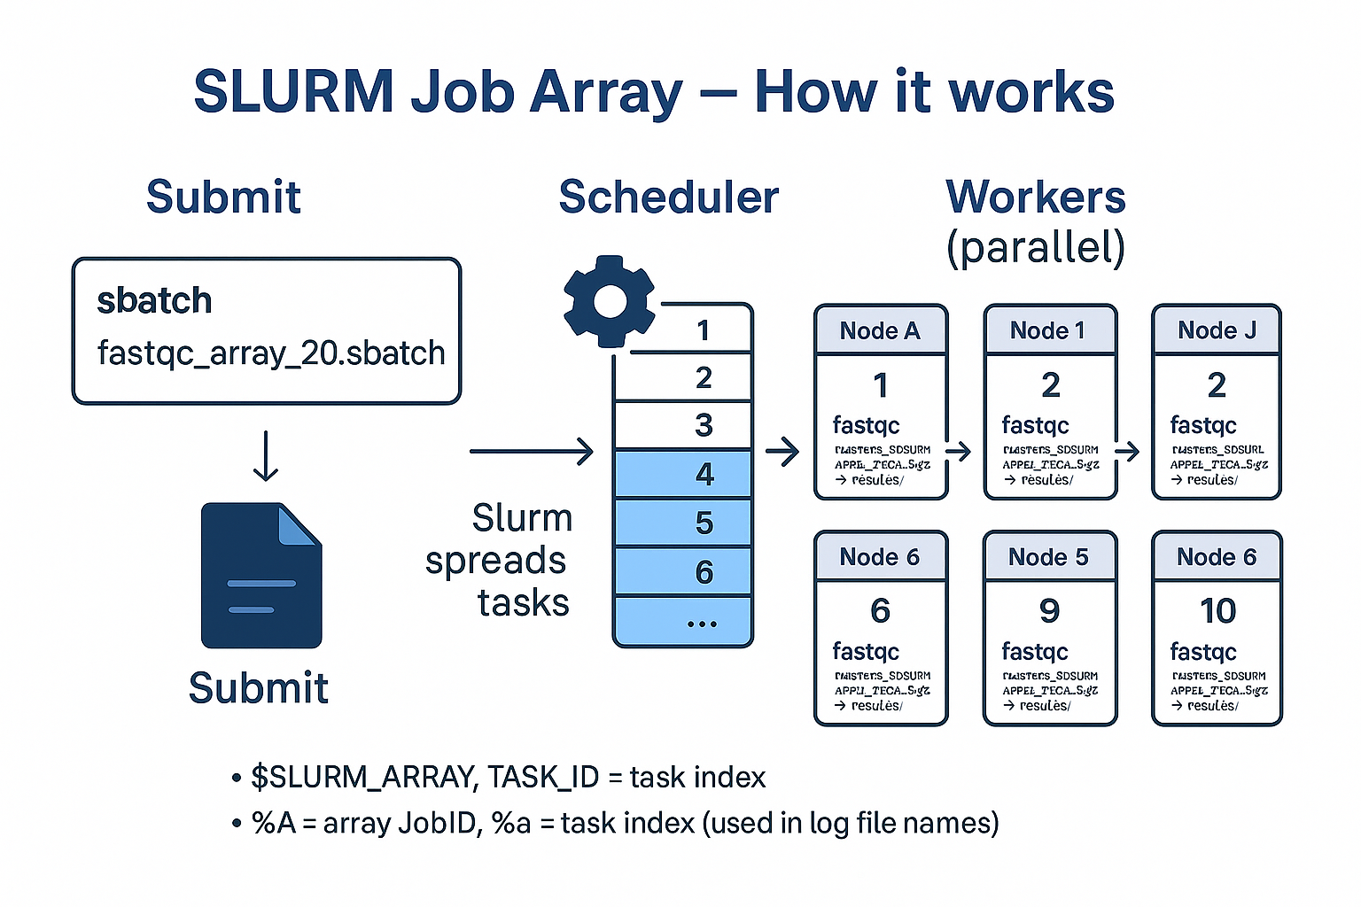

Slide 19
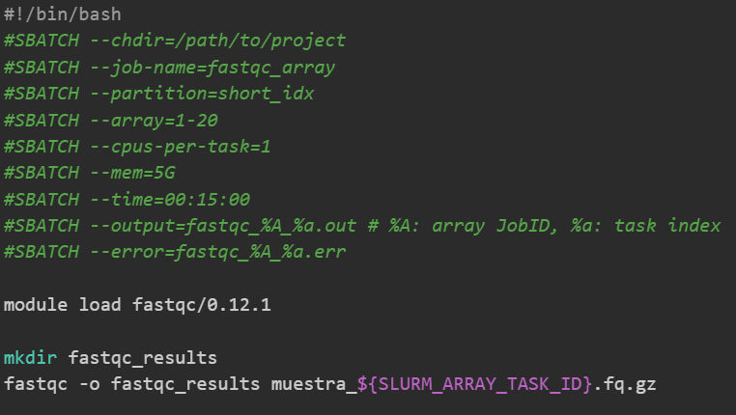
Scripting on the cluster — Slurm: job arrays
Create a JobArray script?
As simple as using the `--array` inside the sbatch script

Slide 20
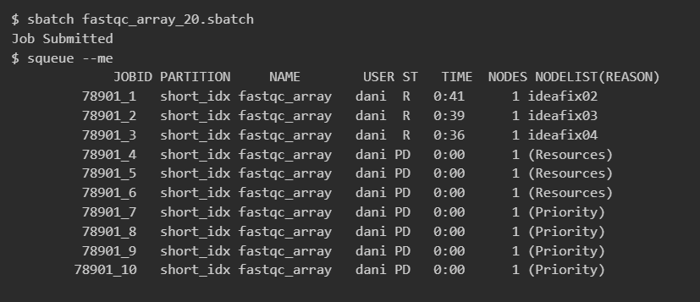
Scripting on the cluster — Slurm: job arrays
Monitoring Arrays

Slide 21
Index
Scripting on the cluster — Slurm: sbatch & job arrays
Parallelization on our cluster — OpenMP vs MPI (when to use each)
From scripts to workflows — building a reproducible pipeline (Nextflow preview)
Wrap-up & Q&A

Slide 22
Thank you for your attention
Questions?

Slide 23
OpenMP v.s. MPI

Slide 24
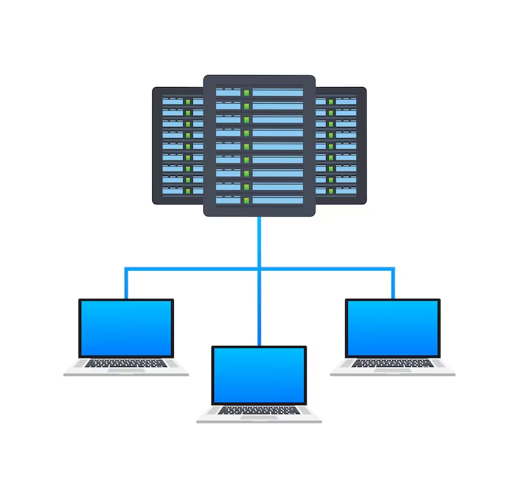
Parallelization on our cluster — OpenMP vs MPI
Parallel programing -- OpenMP and MPI
Parallel programming splits a job into smaller pieces that run at the same time on multiple CPU cores and/or machines.
We use it to finish faster.
In HPC, it reduces time-to-results, makes better use of cluster resources, and cuts wall-clock time for analyses.
The two most used HPC models are OpenMP and MPI.
They target different scenarios: OpenMP (shared memory, one node) vs MPI (distributed memory, many nodes).
Notes:
Parallel programing -- OpenMP and MPI
Parallel programming splits a job into smaller pieces that run at the same time on multiple CPU cores and/or machines.
We use it to finish faster and to handle larger datasets than a single core or single machine can manage.
In HPC, it reduces time-to-results, makes better use of cluster resources, and cuts wall-clock time for analyses.
The two most used HPC models are OpenMP and MPI.
They target different scenarios: OpenMP (shared memory, one node) vs MPI (distributed memory, many nodes).
Parallel programing -- OpenMP and MPI
Parallel programming splits a job into smaller pieces that run at the same time on multiple CPU cores and/or machines.
We use it to finish faster and to handle larger datasets than a single core or single machine can manage.
In HPC, it reduces time-to-results, makes better use of cluster resources, and cuts wall-clock time for analyses.
The two most used HPC models are OpenMP and MPI.
They target different scenarios: OpenMP (shared memory, one node) vs MPI (distributed memory, many nodes).

Slide 25
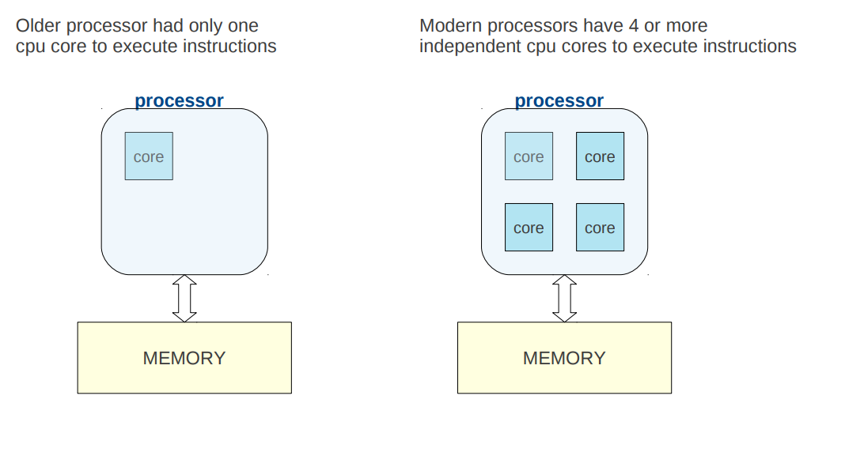
Parallelization on our cluster — OpenMP vs MPI
Parallelization on our cluster — OpenMP
Why parallel programming?
Why parallel computing?

Slide 26
Parallelization on our cluster — OpenMP vs MPI
Parallelization on our cluster — OpenMP
Why parallel computing?
Why parallel computing?

Slide 27
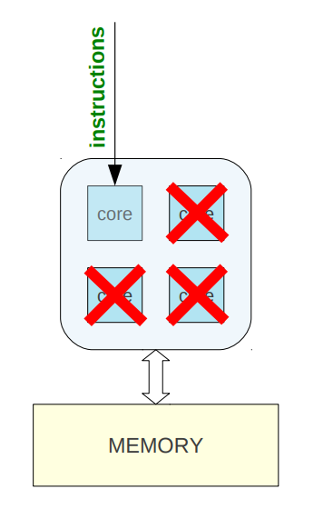
Parallelization on our cluster — OpenMP vs MPI
Why parallel computing?
When you run a sequential program it has an instruction to run a task on 1 core.
Other cores are idle

Slide 28
Parallelization on our cluster — OpenMP vs MPI
Why parallel computing?
When you run a sequential program it has an instruction to run a task on 1 core.
Other cores are idle
Waste of available resources…

Slide 29
Parallelization on our cluster — OpenMP
OpenMP Essentials
Shared-memory parallel model
Lets a program to use multiple threads inside a single process running on a node (usually has >>> CPUs).
That node shares data in a common RAM
Most bioinformatics tools use the OpenMP model
Aligners
Assemblers
Read Processing
Variant Callers
…

Slide 30
Parallelization on our cluster — MPI
MPI Essentials
It is designed to run an application using multiple separate processes, possibly on different nodes of a cluster
When: multinode scaling & very large memory needs.
Shares resources by passing messages over the cluster’s network → network issues can stop the job
Only a few bioinformatics tools use the MPI model
RAxML
IQ-Tree

Slide 31
Parallelization on our cluster — OpenMP vs MPI
KEY DIFFERENCES
Technology | Parallelization level | Communication between processes | Typical use case | Usage (sbatch script)
OpenMP | Within one node | Shared memory: all threads access the same RAM | Align 200 million reads on one node using all its cores | --cpus-per-task (threads) --mem (Ram for the whole process)
MPI | Across multiple nodes | Distributed memory: each node has its own RAM; communication by network | Build a very large phylogenetic tree by splitting the work over 4 nodes | --nodes --ntasks --ntasks-per-node

Slide 32
Parallelization on our cluster — OpenMP vs MPI
KEY DIFFERENCES
Technology | Parallelization level | Communication between processes | Typical use case | Usage (sbatch script)
OpenMP | Within one node | Shared memory: all threads access the same RAM | Align 200 million reads on one node using all its cores | --cpus-per-task (threads) --mem (Ram for the whole process)
MPI | Across multiple nodes | Distributed memory: each node has its own RAM; communication by network | Build a very large phylogenetic tree by splitting the work over 4 nodes | --nodes --ntasks --ntasks-per-node

Slide 33
Thank you for your attention
Questions?

Slide 34

HANDS-ON

